Slide 1


Slide 2




ORIENTATION OF ECAT & FUNGCAT 2021
STARS
ACADEMY
IQBAL TOWN
A Complete E-Learning App
STARS
A Complete E-Learning App
Head Office: Allama Iqbal Town, Lahore. Mob: 0333-1409100, 0300-0603593
website: www.starsentrytest.edu.pk
ACADEMY
IQBAL TOWN

Slide 3
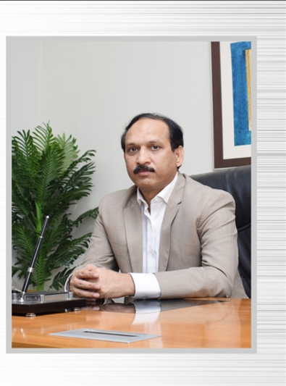

Chairman’s Message
“Education is for all
No Matters Distance and Time”
Mian Muhammad Younas
STARS
A Complete E-Learning App
Head Office: Allama Iqbal Town, Lahore. Mob: 0333-1409100, 0300-0603593
website: www.starsentrytest.edu.pk
ACADEMY
IQBAL TOWN

Slide 4
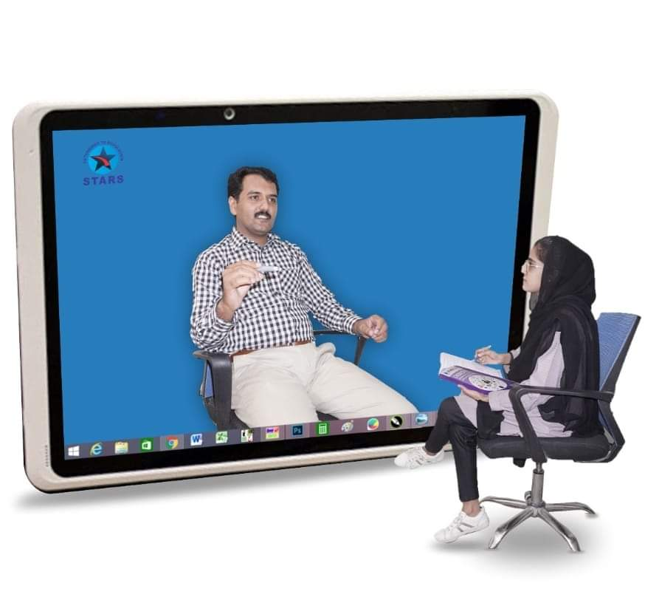
E-Learning App For ECAT & FUNGCAT 2021
To fulfil the students demand and for the successful completion of ECAT & FUNGCAT Preparation, Stars Academy will Provide the following components of online study for ECAT & FUNGCAT 2021
General Orientation about ECAT & FUNGCAT
Subject Orientation (Each Subject)
Transforming learning through
educational Technology
STARS
A Complete E-Learning App
Head Office: Allama Iqbal Town, Lahore. Mob: 0333-1409100, 0300-0603593
website: www.starsentrytest.edu.pk
ACADEMY
IQBAL TOWN

Slide 5

Feature
s
Online full syllabus lectures
Topic wise tests of each subjects
Computer Based test practice
STARS
A Complete E-Learning App
Head Office: Allama Iqbal Town, Lahore. Mob: 0333-1409100, 0300-0603593
website: www.starsentrytest.edu.pk
ACADEMY
IQBAL TOWN

Slide 6

Features
Online test discussion
Time Management Practice
Result Analysis and performance Report
STARS
A Complete E-Learning App
Head Office: Allama Iqbal Town, Lahore. Mob: 0333-1409100, 0300-0603593
website: www.starsentrytest.edu.pk
ACADEMY
IQBAL TOWN

Slide 7

Features
Online home assignments (Each Subject)
More than 10000 MCQ’s practice
Understanding and Recall Based MCQ’s
STARS
A Complete E-Learning App
Head Office: Allama Iqbal Town, Lahore. Mob: 0333-1409100, 0300-0603593
website: www.starsentrytest.edu.pk
ACADEMY
IQBAL TOWN

Slide 8

Features
Books ( By Courier)
Online books solution
Past Papers with Solution
STARS
A Complete E-Learning App
Head Office: Allama Iqbal Town, Lahore. Mob: 0333-1409100, 0300-0603593
website: www.starsentrytest.edu.pk
ACADEMY
IQBAL TOWN

Slide 9

Features
Online Teachers Support
WhatsApp Group discussion support
STARS
A Complete E-Learning App
Head Office: Allama Iqbal Town, Lahore. Mob: 0333-1409100, 0300-0603593
website: www.starsentrytest.edu.pk
ACADEMY
IQBAL TOWN

Slide 10

Features
Access till exams Day
Personalized Learning program
STARS
A Complete E-Learning App
Head Office: Allama Iqbal Town, Lahore. Mob: 0333-1409100, 0300-0603593
website: www.starsentrytest.edu.pk
ACADEMY
IQBAL TOWN

Slide 11

Features
2 times Preparation in single Fee
Updates about Engineering universities polices
STARS
A Complete E-Learning App
Head Office: Allama Iqbal Town, Lahore. Mob: 0333-1409100, 0300-0603593
website: www.starsentrytest.edu.pk
ACADEMY
IQBAL TOWN

Slide 12

Sessions for ECAT & FUNGCAT 2021
Stars Academy Lhr provides Following Sessions Before & After Inter Exams
1st Session Duration is 50 Days
2nd Session Duration is 40 Days
3rd Session Duration is 25 Days
Study at Your Own Pace
Head Office: Allama Iqbal Town, Lahore. Mob: 0333-1409100, 0300-0603593
website: www.starsentrytest.edu.pk
STARS
A Complete E-Learning App
ACADEMY
IQBAL TOWN

Slide 13

E-Learning App For ECAT & FUNGCAT 2021
TO BECOME THE SHINING STAR OF TOMMOROW
TO BECOME ENGINEER JOIN
TO BECOME THE SHINING STAR OF TOMMOROW
STARS ACADEMY LAHORE
STARS
A Complete E-Learning App
Head Office: Allama Iqbal Town, Lahore. Mob: 0333-1409100, 0300-0603593
website: www.starsentrytest.edu.pk
ACADEMY
IQBAL TOWN

Slide 14
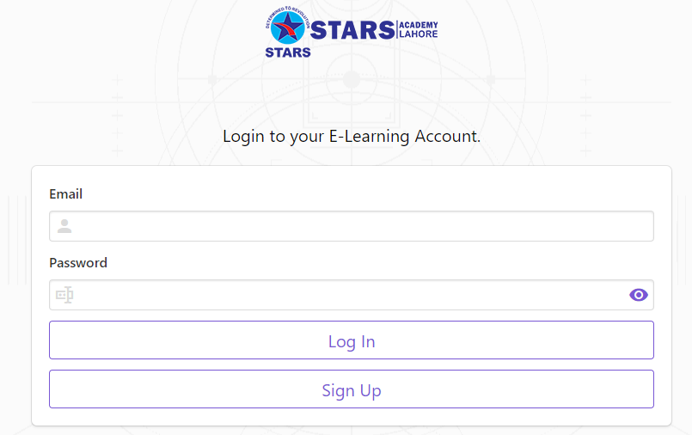
E-Learning App For ECAT & FUNGCAT 2021
Download Stars Academy E-Learning App from play store & Apple Store
https://play.google.com/store/apps/details?id=com.globalteksoft.starelearningapp
STARS
A Complete E-Learning App
Head Office: Allama Iqbal Town, Lahore. Mob: 0333-1409100, 0300-0603593
website: www.starsentrytest.edu.pk
ACADEMY
IQBAL TOWN

Slide 15

E-Learning App For ECAT & FUNGCAT 2021
For more details you can visit our website www.starsentrytest.edu.pk
Contact us on
03331409100, 03000603593
STARS
A Complete E-Learning App
Head Office: Allama Iqbal Town, Lahore. Mob: 0333-1409100, 0300-0603593
website: www.starsentrytest.edu.pk
ACADEMY
IQBAL TOWN

